Slide 1

App Implementation
Elizabeta Budini
Student ID: 19147099
Birmingham City University
Date: 26/05/2020
Notes:
Hi, my name is Elizabeta Budini and I will give a detailed explanation on how I implemented my Film Tourist App for Advanced Mobile Computing coursework at BCU.
I’ll start with a review of the original idea for the app and the aims, analysing if something has changed and why.
Then I’ll present the overall structure of the app, the design, the UI implementation, the data persistence, web services used, additional frameworks and conlusions.

Slide 2
1. Review
The aim was to design a cross-platform app that shows filming locations and movies.
The user is able to search movies, get filming locations for the movie and details (trailer, actors, etc.). The locations are show on the map and the markers are interactive (go to movie details screen).
The user is able to share movies and locations over Facebook, Whatsapp or other social media.
The user cannot receive notifications and ask for a verified badge due to time issues with the project.
The design of the app remained the same except for some minor changes like colors and buttons.
Notes:
All the main features proposed in the App Design have been implemented except the verification badges and push notifications.
The overall design and look-and-feel remained the same with some screens added such as the screen where the user can contribute to the locations database.

Slide 3
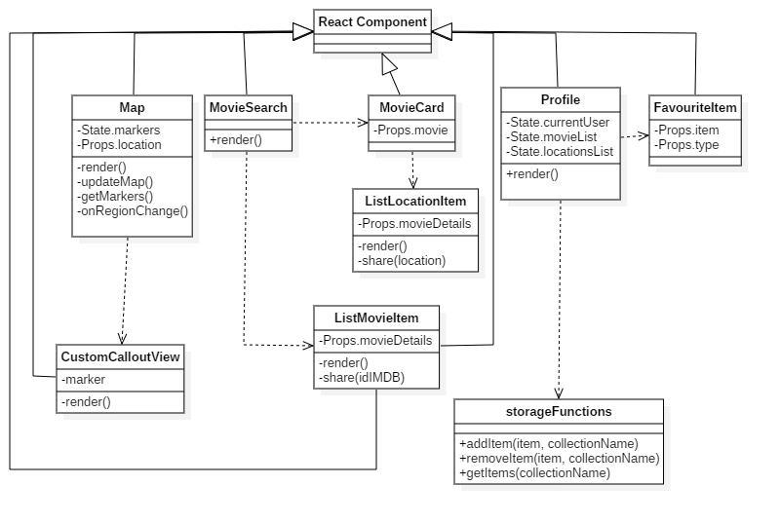
2. Overall app structure
Notes:
The main bottom navigation tab is made by 3 main screens: Map, Movie and Profile.
-Map: shows a list of locations (markers) on a map and focuses the map on user current position or on a specific movie location passed with Props.location.
-The movie screen is composed by MovieSearch, MovieCard and AddModifyLocation. In the class diagram we see that MovieSearch has a list of MovieItems rendered from the database. MovieCard displayes the details of the passed Props.movie and AddModifyLocation (not shown on diagram, to keep the diagram readable) gives the user the opportunity to contribute to the public database of locations.
-Profile screen gives information about the logged-in user (email and avatar), and shows the list of saved movies and saved locations using StorageFunctions.

Slide 4
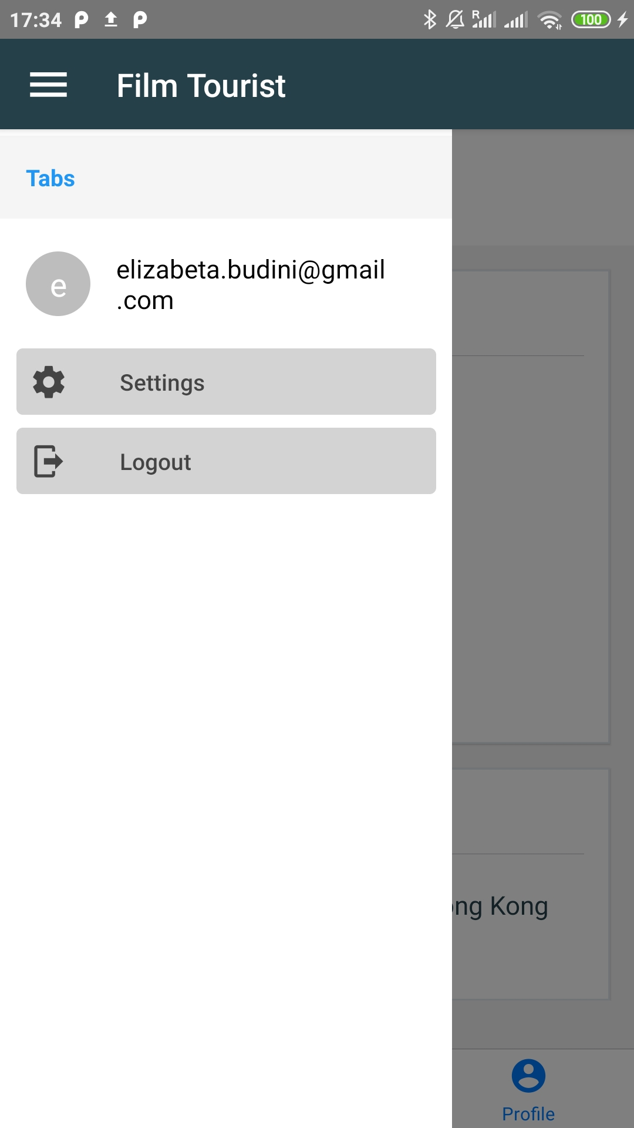
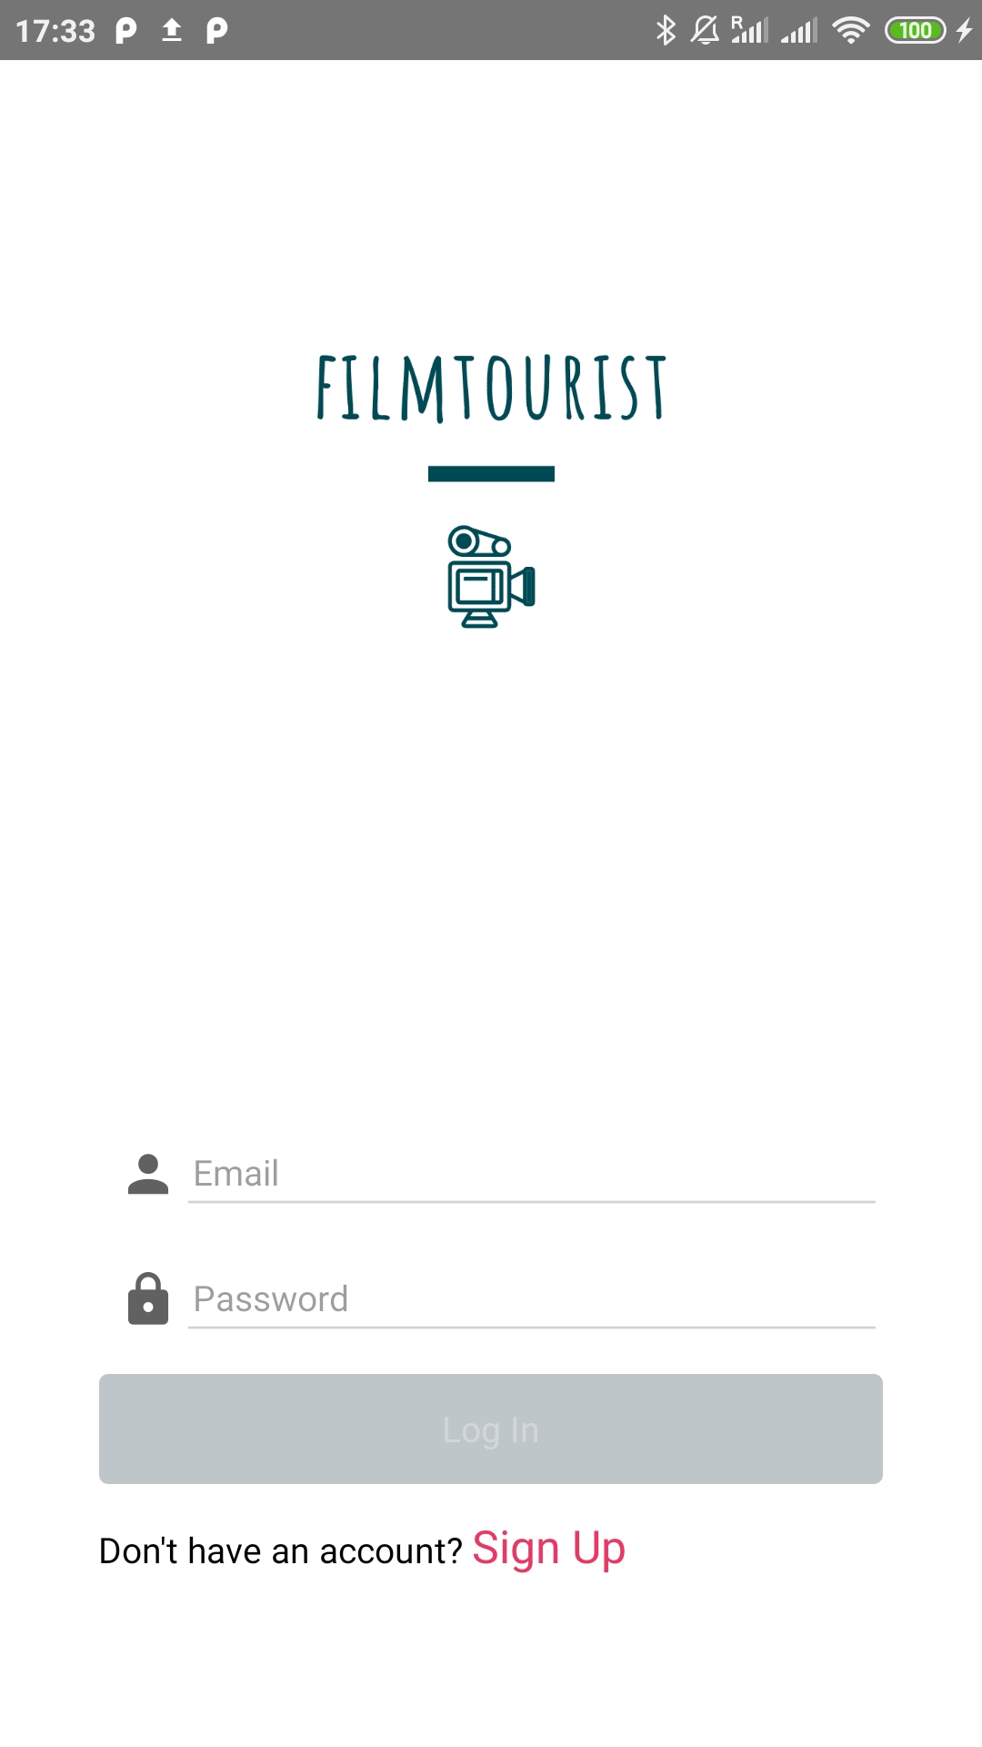
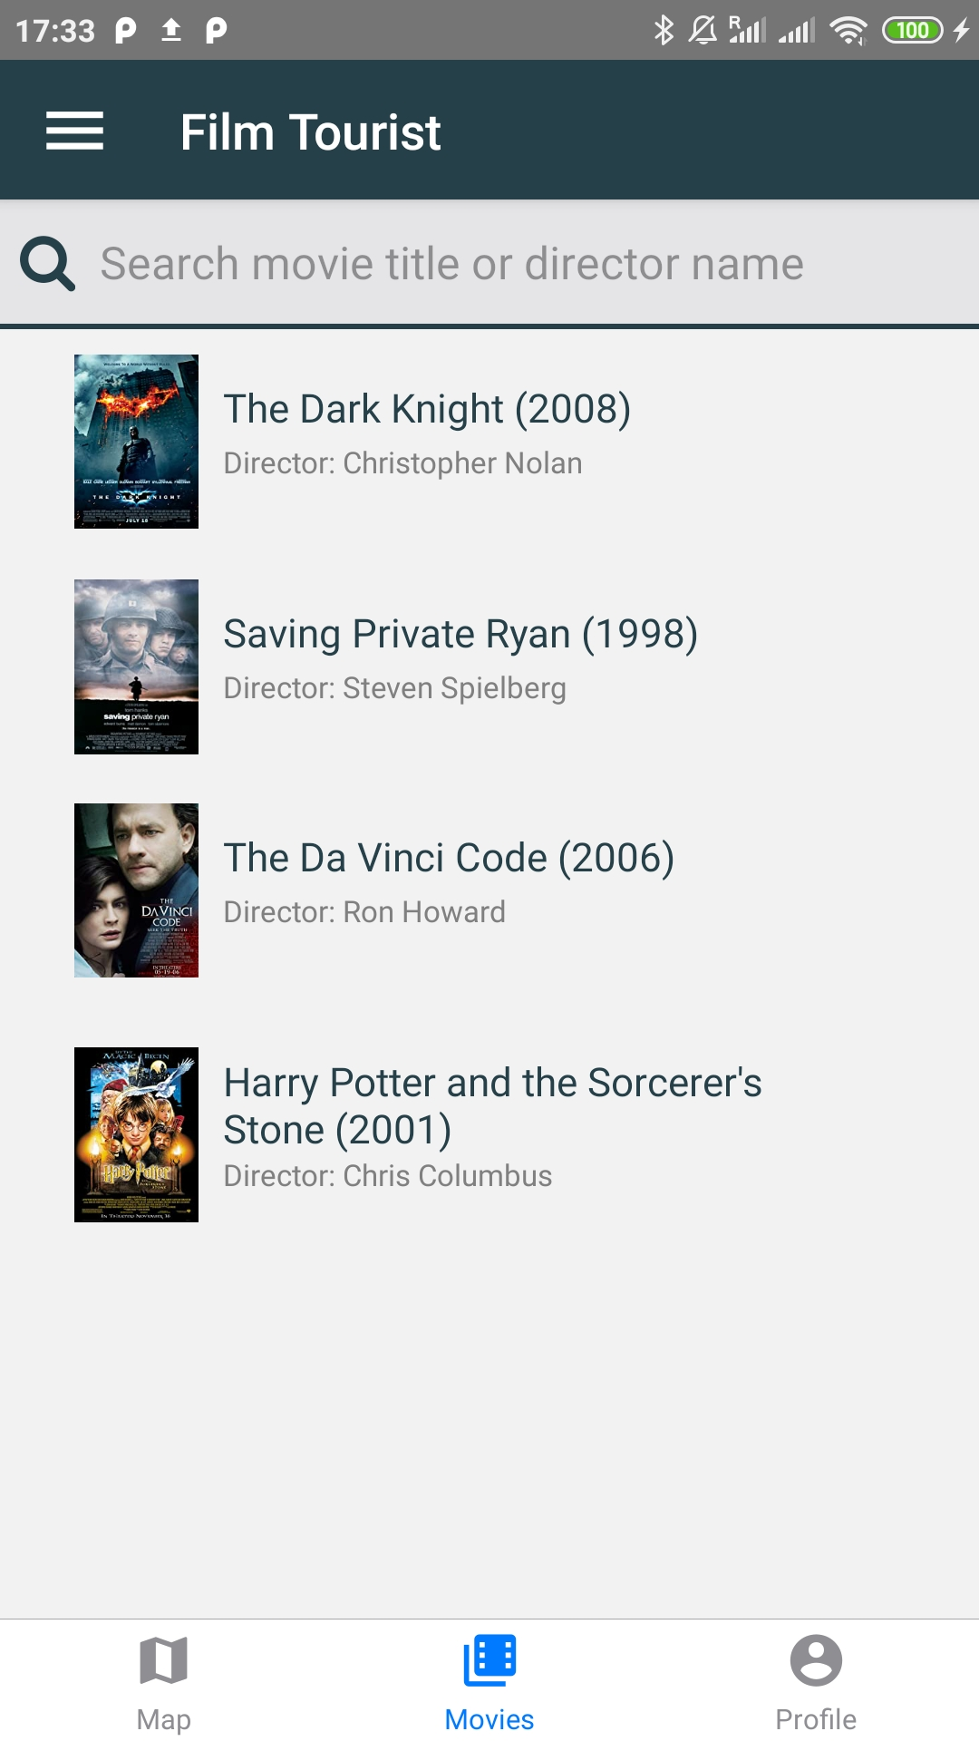
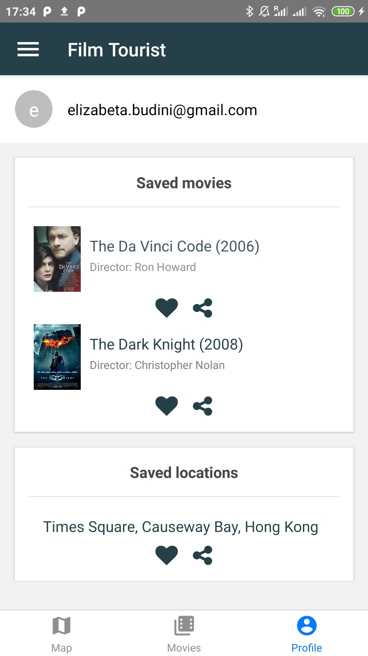
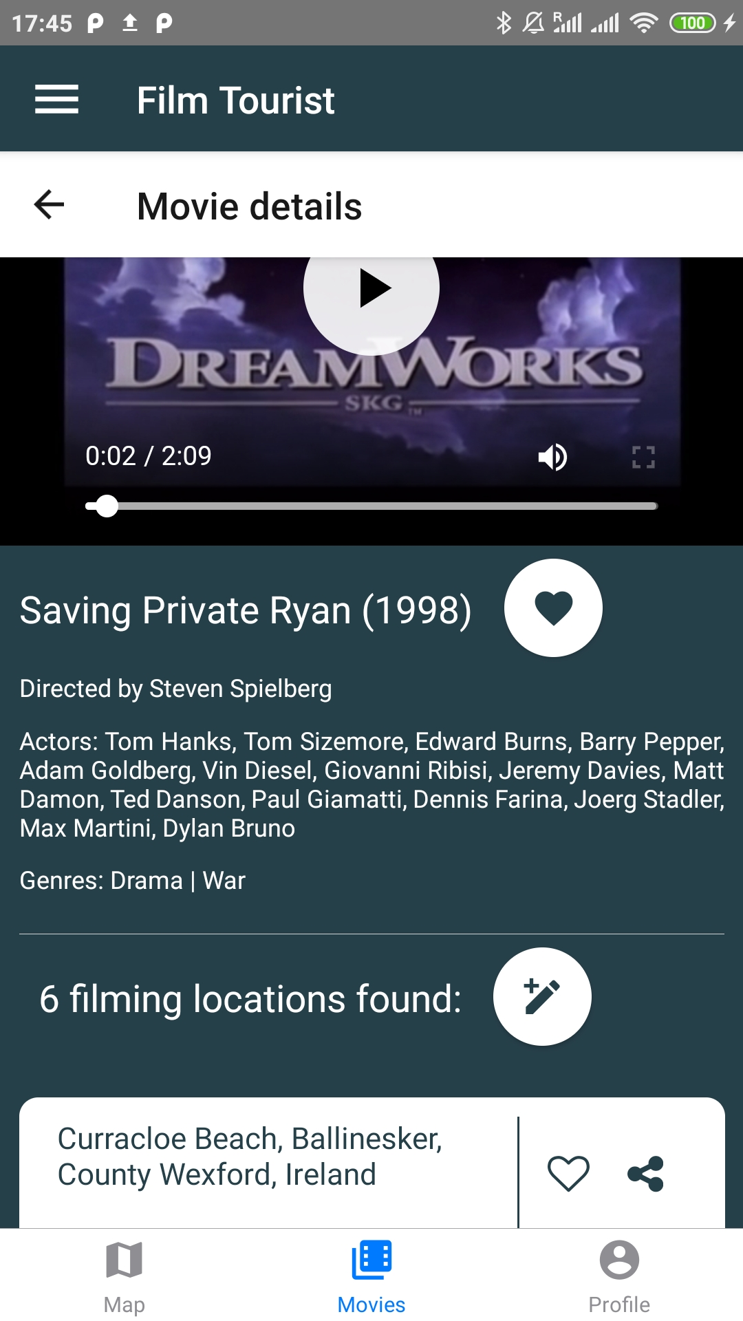
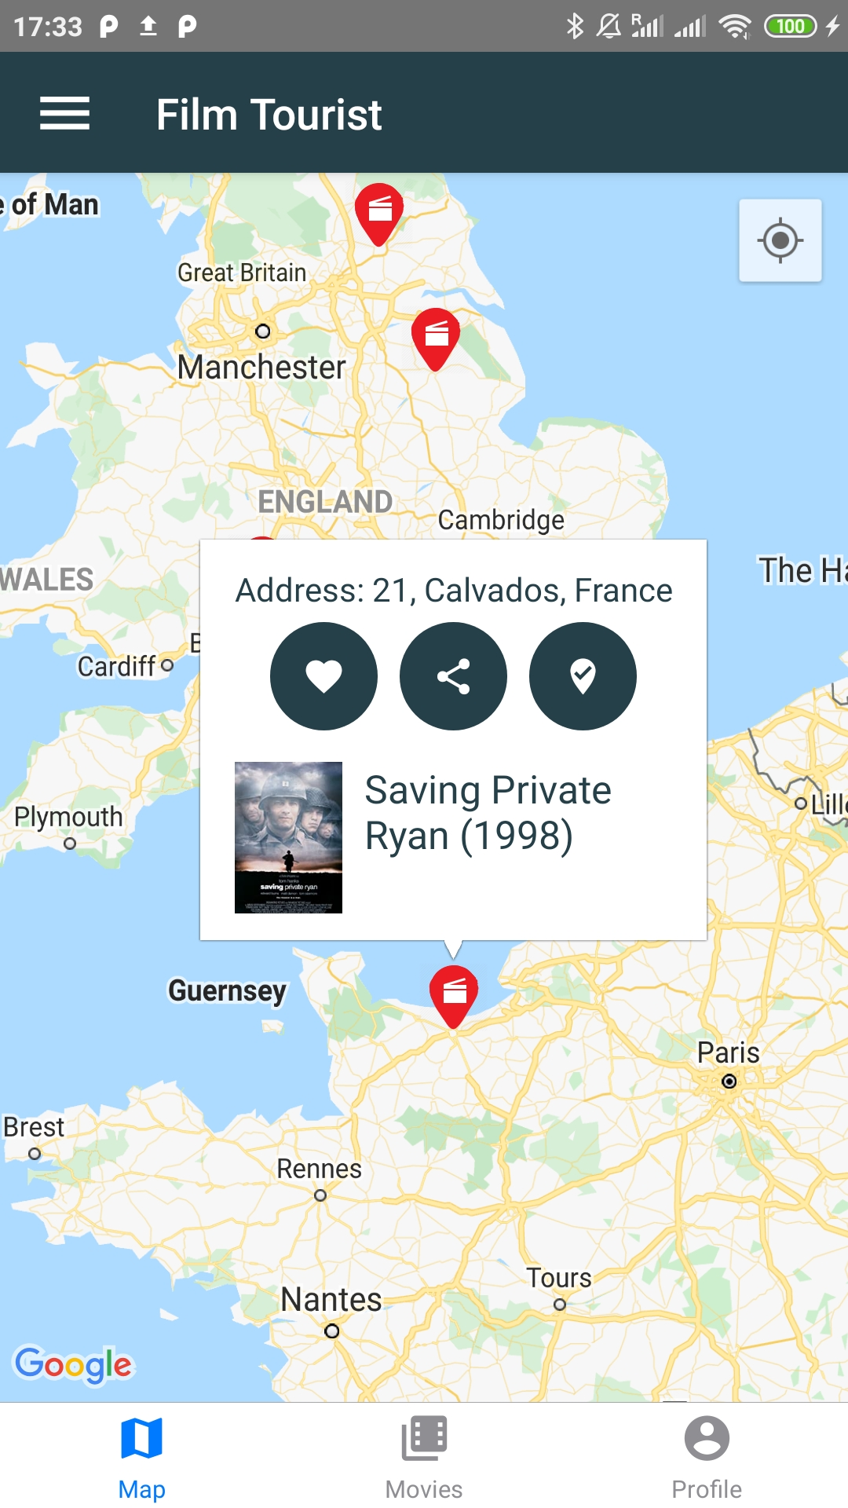
3. Design (1/2)
Notes:
These are the main screens, the map is the first tab shown when the user logs in. There is a drawer which can be opened both by gesture (slide right) or hamburger button.
The user can search for a movie and click on it to get details or long click on it to save it.
From the movie details screen the user can see the list of locations and click on them to navigate to the location on map, share or save them. The user can also click on the pencil icon to contribute to the database of locations for this movie. The last tab is the profile tab which shows the user email, saved movies and saved locations.

Slide 5

3. Design (2/2)
Notes:
Video also available here: https://youtu.be/OLPkz7R_rgE

Slide 6
4. UI Implementation
Map
render() { return ( <View style={{flex: 1}}> <MapView style={styles.map} region={this.state.mapRegion} showsUserLocation={true} followUserLocation={true}> {this.state.markers.map(marker => ( <View> <MapView.Marker coordinate={marker.coords} icon={require('../assets/images/marker.png')}> <MapView.Callout style={{flex: 1, position: 'relative'}} onPress={() => this.props.navigation.navigate('MovieCard', { movieID: marker.id, }) }> <CustomCalloutView marker={marker} /> </MapView.Callout> </MapView.Marker> </View> ))} </MapView> </View> ); }
Custom Callout
……………………..[…]…………………… <View> <Text style={styles.text}>Address: {this.props.marker.address}</Text> </View> <View style={styles.buttons}> <TouchableOpacity onPress={() => addItem(this.props.marker, 'locations')} style={styles.myButton}> <Icon name={'heart'} style={styles.iconStyle} /> </TouchableOpacity> <TouchableOpacity style={styles.myButton}> <Icon name={'share-variant'} style={styles.iconStyle} /> </TouchableOpacity> <TouchableOpacity style={styles.myButton}> <Icon name={'map-marker-check'} style={styles.iconStyle} /> </TouchableOpacity> </View> <View style={{flexDirection: 'row-reverse', marginTop: 10}}> <Text style={styles.title}> {this.props.marker.title} ({this.props.marker.year}) </Text> <View style={{ height: 70, width: 50, }}> <WebView source={{uri: this.props.marker.poster}} /> ……………….[..]………………….
Notes:
The mapView renders the markers using this.state.markers.map->[…]. The markers list of coordinates are mapped into <Marker> items. Each marker when clicked shows a callout, which in this case is customized to show the address, the title and the poster as a <WebView> because the callout does not render properly the <Image> component.

Slide 7
4. UI Implementation
Bottom Tab navigation in Home.js
………[…]……………
const Bottom = createBottomTabNavigator( { Map: Map, Movies: nav, Profile: Profile, }, { initialRouteName: 'Map', defaultNavigationOptions: ({navigation}) => ({ tabBarIcon: ({focused, horizontal, tintColor}) => { const {routeName} = navigation.state; let iconName; if (routeName === 'Map') { iconName = 'map'; } else if (routeName === 'Profile') { iconName = 'account-circle'; } else if (routeName === 'Movies') { iconName = 'library-movie'; } return <Icon name={iconName} size={25} color={tintColor} />; ………[…]……………
App.js
const AppNavigator = createSwitchNavigator( { Loading: Loading, SignUp: SignUp, Login: Login, Home: Home, }, { initialRouteName: 'Loading', }, );
Navigation example
<TouchableOpacity style={styles.desc} onPress={() => this.props.navigation.navigate('Map', { location: this.props.item.location,}) }> <Text style={styles.text}>{item.location}</Text> </TouchableOpacity>
Notes:
The main entry point is App.js, this file is implemented as a switchNavigator with 4 available screens: Loading, Login, SignUp, Home. The first one is Loading.js which holds the logic and detects if the user is logged-in or not. If the user is logged-in, the Home screen is shown (with Map, Profile, Movies tab navigator) otherwise the login Screen is shown (with options to navigate to signup). The Home component is implemented so that there are 3 main screens and a tab to navigate them: Map, Profile, Movies.
To navigate between screens, the navigation object is accessed through the props passed between screens along with parameters that can be accessed with navigation.state.params. In this case the navigation example show the navigation to the map screen, passing the location where the map should focus.

Slide 8
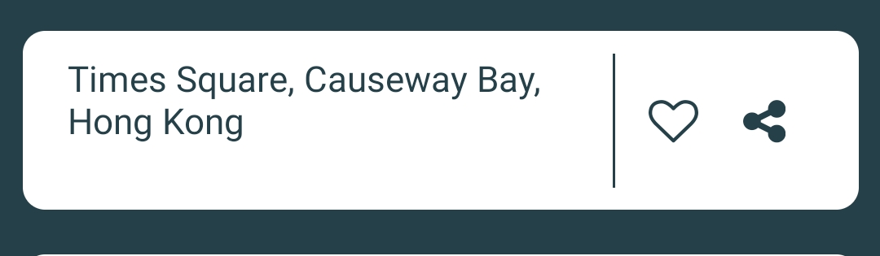
4. UI Implementation
render() { const {item, modify, firebaseKey} = this.props; return modify ? ( //edit mode, for the user to contribute to locations database …………[…]………
) : ( //visualize mode, for the user to see locations in movie card screen <View style={styles.containerStyle}> <TouchableOpacity style={styles.desc} onPress={() => this.props.navigation.navigate('Map', { location: this.props.item.location, }) }> <Text style={styles.text}>{item.location}</Text> </TouchableOpacity> <View style={{flexDirection: 'row'}}> <TouchableOpacity onPress={() => addItem(item, 'locations')}> <Icon name={'heart-o'} style={styles.iconStyle2} /> </TouchableOpacity> <TouchableOpacity onPress={() => this.share(item.location)}> <Icon name={'share-alt'} style={styles.iconStyle2} /> </TouchableOpacity> </View> </View> ); }
Location list item
return modify ? ( //edit mode, for the user to contribute to locations database <View style={styles.containerStyle}> <View style={styles.desc2}> <Text style={styles.text}>{item.location}</Text> </View> <View style={{flexDirection: 'row'}}> <TouchableOpacity onPress={() => manageItem('', item.location, firebaseKey, 'remove').then( this.props.navigation.goBack, ) }> <Icon name={'trash'} style={styles.iconStyle2} /> </TouchableOpacity> </View> </View> ) : (
Notes:
Location list item is used in two contexts: user contribution (modify/ad) or list item in movie details. The behaviour to be shown is stored in ‘modify’ boolean variable which is passed from the parent as a prop.
The behaviour in the first box is in edit mode: the user can delete from Firebase databse the item
The behaviour shown in the second yellow box (modify= false) has 3 onPress functions: one to save the location in Async Storage, one to share the location on social medias and the third one is clicking on the location item to show it on the map.

Slide 9
5. Data persistence
Add item function
export const addItem = async (item, collectionName) => { try { //if the item passed is the first to be saved for that collection //we need to create a new key for the array const existingItems = (await AsyncStorage.getItem(collectionName)) || '[]'; let itemList = JSON.parse(existingItems); //if the item does not exist in the storage, indexOf will return -1 let index = itemList.indexOf(JSON.stringify(item)); //check if item is already been saved in storage if (index === -1) { //adding the new item to the list itemList.push(item); //creating or updating the list await AsyncStorage.setItem(collectionName, JSON.stringify(itemList)) .then(() => { RNToasty.Success({ title: 'Great! The item has been saved to your collection', }); }) .catch(() => {}); } else { //item already saved in storage RNToasty.Info({ title: 'Check you profile: the item is already in your collection', }); } } catch (error) { RNToasty.Error({ title: 'Try again, an error occurred while saving the item', }); console.log(error); } };
Add new location to AsyncStorage
<TouchableOpacity onPress={() => addItem(item, 'locations')}>
Get movies or locations
async getItems(collectionName) { let items = []; console.log('Profile.js -> Getting items from:’, collectionName); try { const collection = await AsyncStorage.getItem(collectionName); items = JSON.parse(collection); } catch (error) { console.log(error, 'error'); } finally { if (collectionName === 'movies') { this.setState({movieList: items}); } else { this.setState({locationsList: items}); } } }
Notes:
Favourite movies and favourite locations are stored on device with AsyncStorage. The storage has two arrays, one for locations and one for movies. So it has two keys and to get one or the other list we need to select one of these keys. The methods (add, remove, get) have the same logic so that’s why it’s implemented only once, and based on the collectionName given the methods selects movies or locations array. Inserting a new object needs a check because the items are stored in a child array (2 async storage keys for the arrays). To add a new item we download the collection from async storage, parse it into an array, add the item and push the array again up.

Slide 10
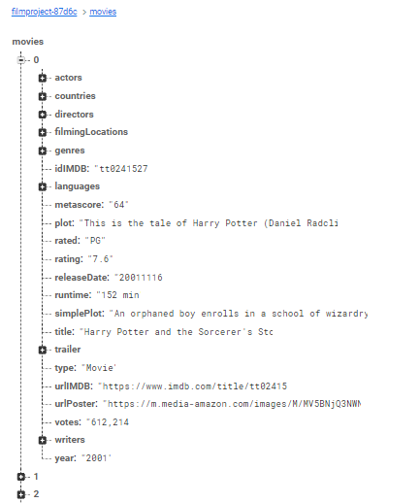
6. Web services
https://filmproject-87d6c.firebaseio.com/movies/.json
async getMovieDetails(movieID) { //find movie from firebase database var movie = ''; var firebaseK = ''; await database .ref('/movies') .orderByChild('idIMDB') .equalTo(movieID) .once('value', function(snapshot) { for (const key in snapshot.val()) { movie = snapshot.val()[key]; firebaseK = key; } }); this.setState({firebaseKey: firebaseK}); this.setState({movieDetails: movie}); //new IDs created when user adds a new location are not recognized by React Native so we use Object.values this.setState({locationList: Object.values(movie.filmingLocations)}); this.setState({nLocations: Object.values(movie.filmingLocations).length}); var directors = []; //extract director names and separate with comma directors = movie.directors.map(item => item.name).join(', '); this.setState({directors: directors}); this.setState({isLoading: false}); }
Notes:
Firebase Realtime Database hold the movie data, so that it can be modified and updated by the user. The data was previously downloaded from myFilmAPI and imported in movies database: https://filmproject-87d6c.firebaseio.com/movies/.json. To read or write data we use a reference to the firebase database, given a movieID we need to find the path and use once() method of firebase.database.Reference get a snapshot of the data and val() method to retrieve data. Movies are indexed randomly by Firebase and the index is not the ID of the movie. Firebase guidance followed to retrieve data: https://firebase.google.com/docs/database/web/read-and-write
Some json arrays, such as directors, actors, genres, are joined with commas to display the list in the movie details screen.

Slide 11
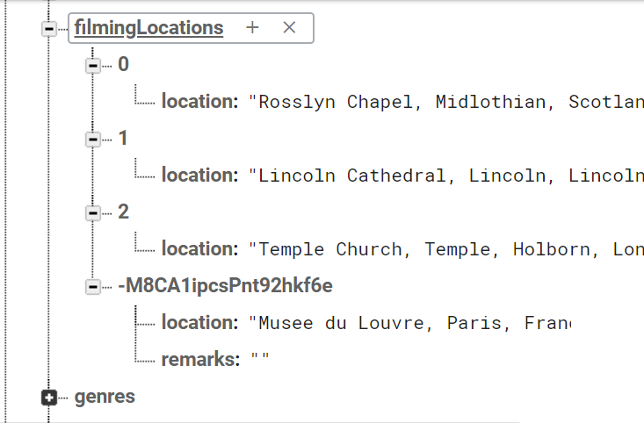
6. Web services
manageItem()
…..[…]…..
const locationAdd = { location: newLocation, remarks: '', };
console.log('key firebase location:', locK);
if (locK === '') { await filmingLocRef.push(locationAdd); RNToasty.Success({ title: 'Thank you for your contribution. Item added', }); } else { if (action === 'modify') { await filmingLocRef.child(locK).update(locationAdd); RNToasty.Success({ title: 'Thank you for your contribution. Item updated', }); } else { await filmingLocRef.child(locK).remove(); RNToasty.Success({ title: 'Thank you for your contribution. Item removed',
Add/modify/remove item: user contribution to app database
ADD
MODIFY
REMOVE
Example of modify/add
onPress={() => manageItem(newLocation, oldLocation, firebaseKey, 'modify').then(this.props.navigation.goBack) }>
Notes:
The user can contribute to the public database. manageItem() handles adding, deleting or modifying the locations for a given movie (‘firebaseKey’).
The action(modify/delete), the new address, old address and movie firebase key are passed as parameters. First, we try to find the key (assigned to ‘locK’ variable) for the given old address, if the the key is not found it means that the action of the user cannot be MODIFY or REMOVE so we assume that the user wants to add a new location. If the key is found then we check if the user wants to remove or modify the oldLocation.

Slide 12
6. Web services
Search movie
Algolia configuration
export default class MovieSearch extends React.Component { constructor() { super(); this.handleClick = this.handleClick.bind(this); } handleClick(item) { this.props.navigation.navigate('MovieCard', {movie: item}); } //Adapted from https://blog.expo.io/using-algolia-to-implement-search-within-an-expo-firebase-project-da66e3aa8239 /* InstantSearch is a Algolia Componenet to search in a Firebase database which doesn't have indexing */ render() { return ( <View style={styles.mainContainer}> <InstantSearch searchClient={client} indexName={'movies'}> <View style={styles.searchContainer}> <ConnectedSearchBar /> </View> <ConnectedHits navigation={this.props.navigation} /> </InstantSearch> </View> ); } }
import algoliasearch from 'algoliasearch'; import {database} from './firebase'; // configure algolia export const client = algoliasearch(ALGOLIA_ID, ALGOLIA_ADMIN_KEY); const index = client.initIndex(ALGOLIA_INDEX_NAME); const movieRef = database.ref('/movies'); movieRef.on('child_added', addOrUpdateIndexRecord); movieRef.on('child_changed', addOrUpdateIndexRecord); movieRef.on('child_removed', deleteIndexRecord); function addOrUpdateIndexRecord(contact) { // Get Firebase object const record = contact.val(); // Specify Algolia's objectID using the Firebase object key record.objectID = contact.key; // Add or update object index .saveObject(record) .then(() => { console.log('Firebase object indexed in Algolia', record.objectID); }) .catch(error => { console.error('Error when indexing contact into Algolia', error); process.exit(1); }); }
Notes:
To search movies by title or director we use a third-party library: Algolia.
It’s a tool suggested by Firebase to efficiently add search capabilities to Firebase Realtime database. It gives full-text search, typo tolerance and support for advanced features such as instant search.
Algolia keeps an updated copy of firebase database registering (using ref.on() method) to ‘child_added’, ‘child_changed’ and ‘child_removed’ firebase events.

Slide 13
7. Additional frameworks
Social media share
GeoLocation and Geocoder
share(idIMDB) { var url = 'https://www.imdb.com/title/' + idIMDB + '/'; Share.open({url: url}) .then(res => { console.log(res); }) .catch(err => { err && console.log(err); }); }
Geolocation.watchPosition(position => { let region = { latitude: position.coords.latitude, longitude: position.coords.longitude, latitudeDelta: 0.00922 * 1.5, longitudeDelta: 0.00421 * 1.5, }; this.onRegionChange(region, region.latitude, region.longitude);
share(location) { Geocoder.from(location) .then(json => { var coords = json.results[0].geometry.location; var url = 'https://www.google.com/maps/?q=' + coords.lat + ',' + coords.lng; Share.open({ url: url, message: this.state.movieDetails.title + ' was filmed here!', }) .then(res => { console.log(res); }) .catch(err => { err && console.log(err); }); }) .catch(error => console.warn(error)); }
Geocoder.from(loc) .then(json => { var location = json.results[0].geometry.location; //focus on location given let region = { latitude: location.lat, longitude: location.lng, latitudeDelta: 0.00622 * 1.5, longitudeDelta: 0.00221 * 1.5, }; this.onRegionChange(region, region.latitude, region.longitude); }) .catch(error => console.warn(error));
Notes:
Geocoder: The movie locations are in address format which Google Maps cannot automatically render into a marker. So we use Geocoder to get latitude and longitude based on the address.
Geolocation: When the map is shown we need to get the user location to focus the map close to his position.
Social media share: the user can share a location or a movie. When sharing a movie, we get the official IMDB web page for the movie and share the link. In case of a location given, we get the coordinates and get the Google Maps location to be shared as a link.

Slide 14
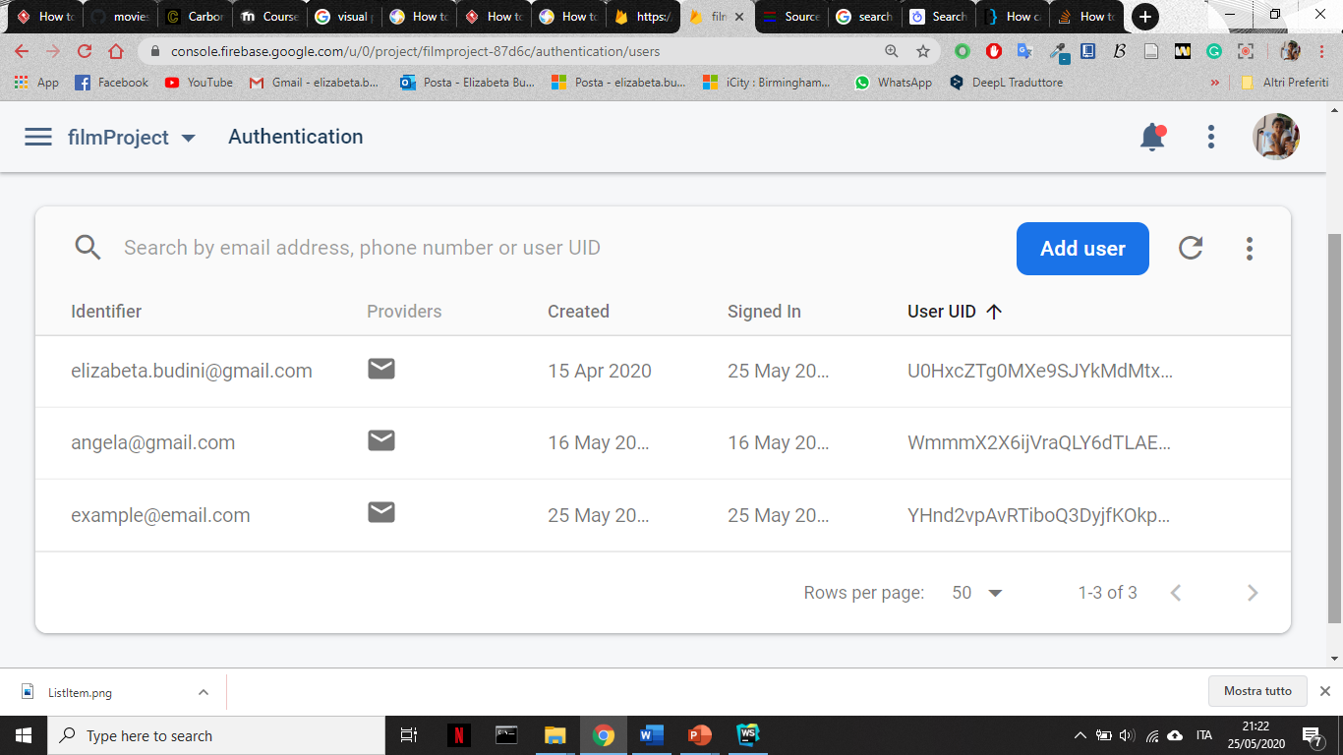
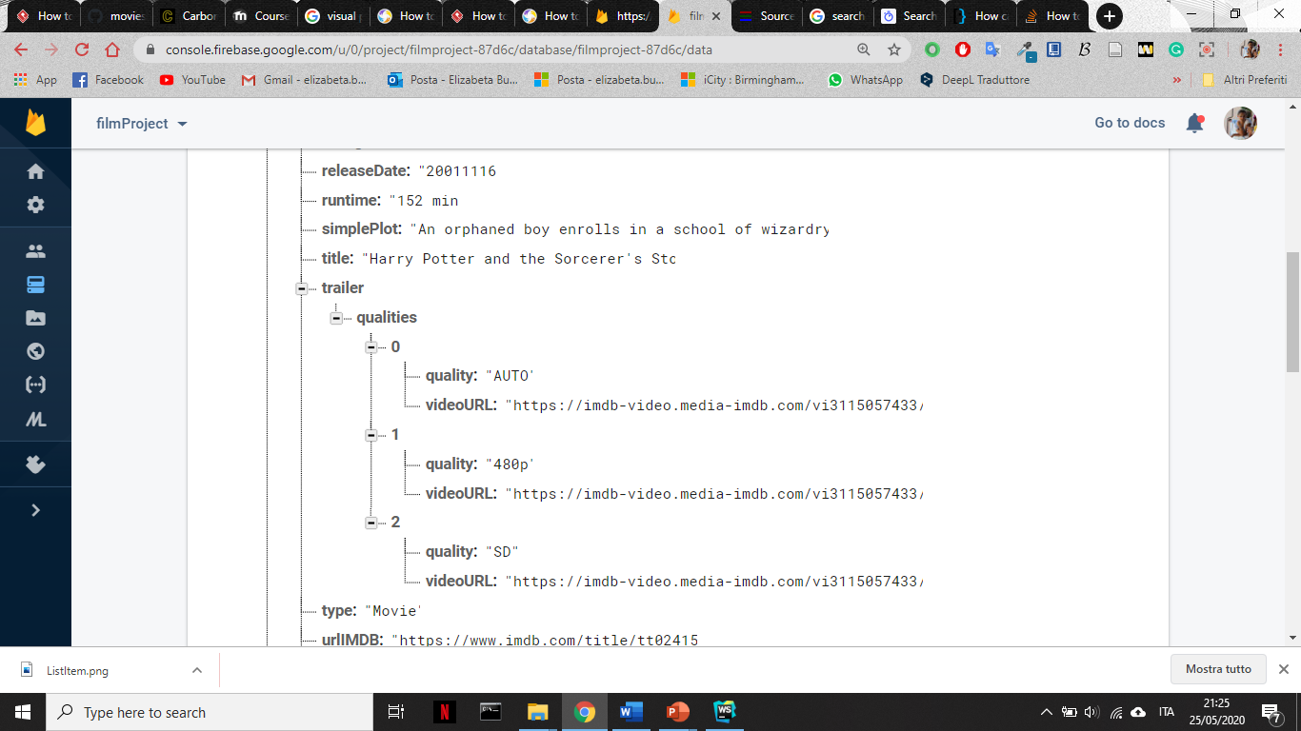
7. Additional frameworks
Authentication
WebView
handleLogin = () => { const {email, password} = this.state; auth .signInWithEmailAndPassword(email, password) .then(() => this.props.navigation.navigate('Main')) .catch(error => this.setState({errorMessage: error.message})); };
<WebView style={styles.imageStyle} javaScriptEnabled={true} source={{ uri: movieDetails.trailer.qualities[0].videoURL, }} />
Notes:
Authentication: to be able to modify the Firebase database, the user needs to be logged in. Firebase SDK Authentication creates and manages the users in our App and also gives information about authentication status. In our case we use an ‘Email and password based’ authentication approach.
WebView: to show movie trailers in the movie details screen, we use a WebView tag with a url to the video in IMDB Amazon database.

Slide 15
8. Conclusions
Implemented features:
Succesfully created a cross-platform app easy and intuitive to use.
User can login, persist data on device and modify the Firebase database.
Additional frameworks implemented: Geolocation, social media.
Future challenges:
Verify user location and give badge to motivate the user on travel for filming locations
Push notification not implemented due to limited time
Notes:
Overall the app met the deisgn expectations, the slide shows the implemented features and future challenges.

